Slide 1

Object – Oriented Programming
Iksan Bukhori, M.Phil.

Slide 2
References
Phillips, D. Python 3 Object-oriented Programming. 2nd Edition. Packt Publishing Ltd, 2015.
Downey, A. Think Python. 2nd Edition. Green Tea Press, 2015.
Lutz, M. Learning Python: powerful object-oriented programming. O’Reilly Media, 2013
Lott, S.F. and Philips, D. Python Object-Oriented Programming: Build robust and maintainable object-oriented Python applications and libraries. Packt Publishing Ltd, 2021.

Slide 3
Grading
- Mid-Term Exam : 30 %
- Final Exam : 40 %
- Quizzes : 20 %
- Homework/Assignment : 10%
WARNING: There will be no extra assignments!!
Final grades may be adjusted; however, you are guaranteed the
following:
If your final score is 85 - 100, your grade will be A.
If your final score is 70 - 84, your grade will be B.
If your final score is 60 - 69, your grade will be C.
If your final score is 55 - 59, your grade will be D.
If your final score is < 55, your grade will be E.

Slide 4
Rules and Regulations
All Materials will be uploaded to eCampus
You are advised to have a WA/Line group consisting of all students in the course to make the flow of information fast
You are allowed to not activate your webcam during the online sessions, except when you are being asked to do so specifically and during several moments which will be explained below
Attendance will be taken every week 10 minutes into the session by roll-calling. You should turn on your camera when your name is called.
You should also turn on your camera the whole time during Quiz/Exams.
Homework/Assignment should be submitted at most one week after it was announced by submitting the project folder in compressed form either to eCampus or Email (Will be decided later). Each folder project should be named using the following format: OOP_HW1_IksanBukhori_20201

Slide 5
Penalties
You are allowed to not attend the class without permission at most 4 times. When one missed without permission/warning for the 5th time, he/she automatically failed the course.
Cheating is strictly forbidden during Quiz/Exams. Anyone who’s indicated to have cheated at one or more problems in the quiz/exam will have the score for those particular problems nullified. This indication could be in the form of having the same answer, not turning on their camera during exams, or appeared to be texting/calling someone while in exam.

Slide 6
Attitude
Please pay attention to the class.
Ask if you have any question (you may stop me at any point during my explanation)
Answer if I ask the class something which required verbal answer
Don’t be shy to ask me to repeat the parts where you did not understand, either because of the language barrier or because I was speaking too fast. I’d gladly repeat that part.
If you have some sort of technical difficulties (losing internet connection, your laptop crashes, etc.) please tell me by WA or in the course’s WA group I belong.

Slide 7
Quiz and Exams
Quiz is held every meeting starting from week #2, 15 minutes after the class begins, consisting one or two short questions related to the material from the previous week
Since there are 14 non-exam weeks, there will be (about) 14 quizzes. Lowest 20% grade of these quizzes (e.g., if there are 14, then the lowest 2) will be dropped.
Quizzes will be done online using eCampus, unless other method is specified
Mid Term and Final Term Exams will be held offline as scheduled

Slide 8
Syllabus
Week | Topic
1 | Intro to Object Oriented Programming
2 | Review of Python and Fundamentals of Procedural Programming
3 | Classes and Objects
4 | Data Structures
5 | Constructors and Destructors
6 | Class Methods
7 | Review
8 | Mid Exam
Week | Topic
9 | Inheritance
10 | Polymorphism
11 | Abstract Classes and Methods
12 | Exceptions Handling
13 | String Operation
14 | Files Operation
15 | > Quiz+Review
16 | Final Exam/Final Project

Slide 9
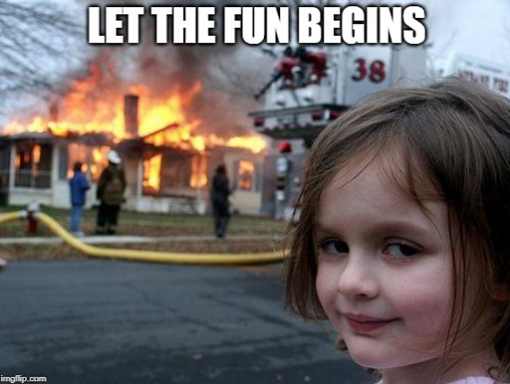
No Question?

Slide 10
Topic 1: Intro to Object Oriented Programming
Most Materials in this slide are taken from a video by freecodecamp.org channel:
Intro to Object Oriented Programming - Crash Course

Slide 11
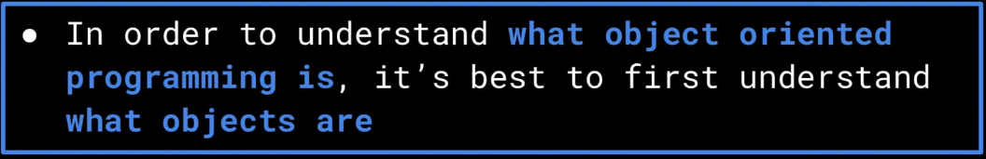
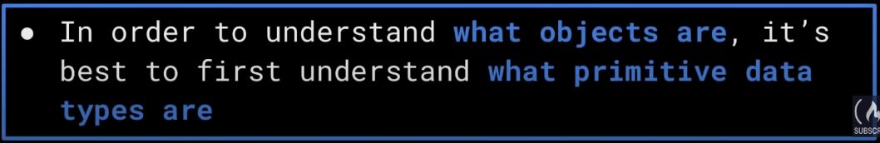
Why Primitive Data Type Isn’t Enough

Slide 12
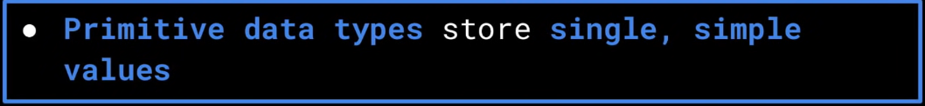
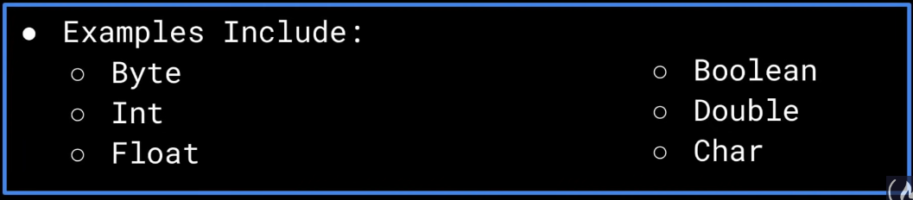
What is Primitive Data Type?

Slide 13
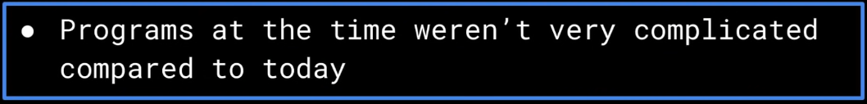
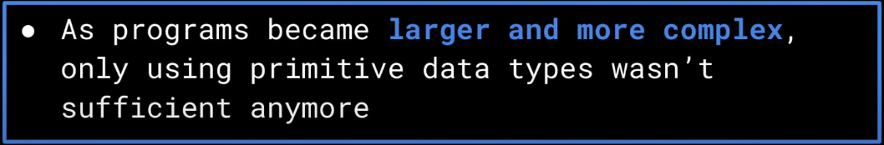
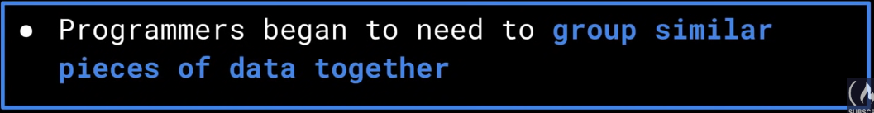
Primitive Data Type

Slide 14



Example
Position
Captured
Colour

Slide 15


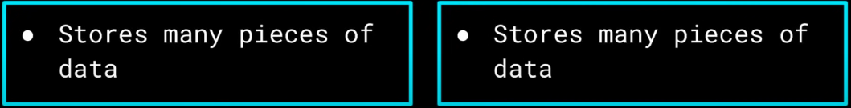
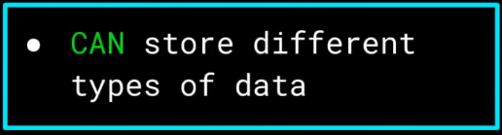
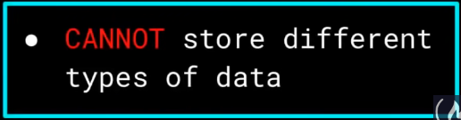
Can We use Structure? Or Array?

Slide 16
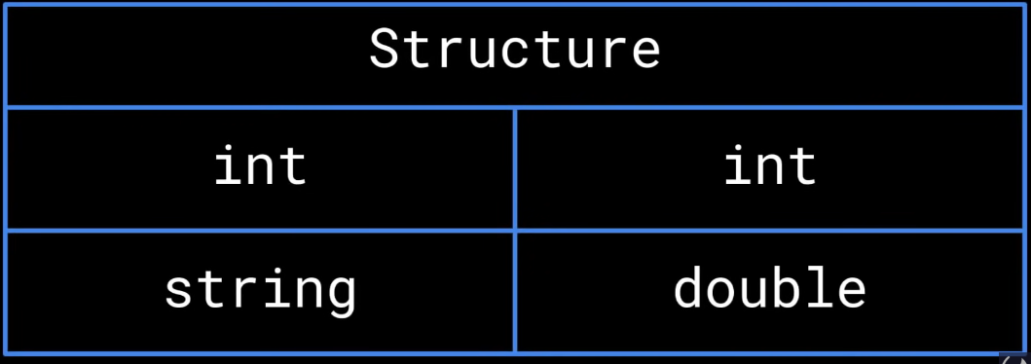
Can We use Structure?

Slide 17
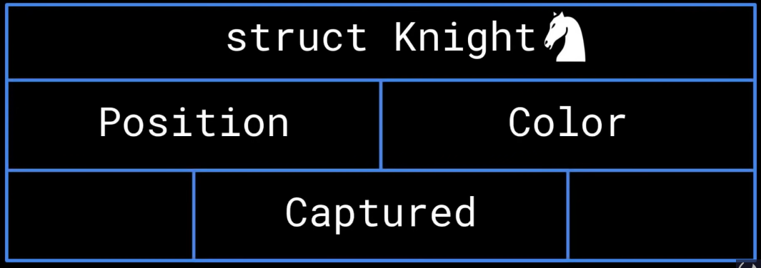
Can We use Structure?

Slide 18
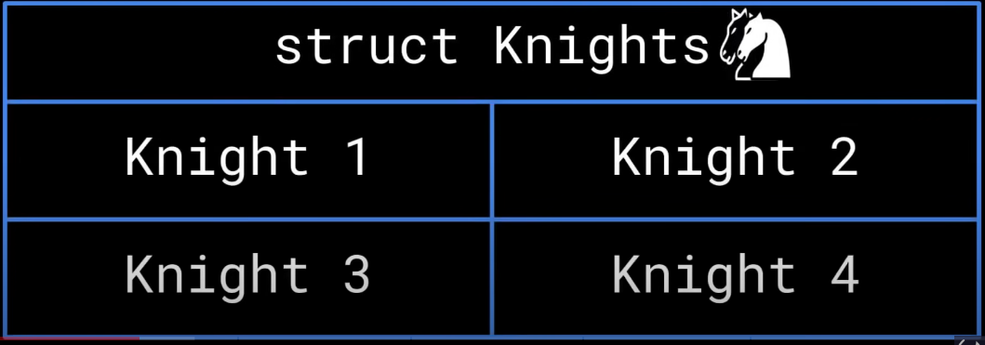
Can We use Structure?

Slide 19
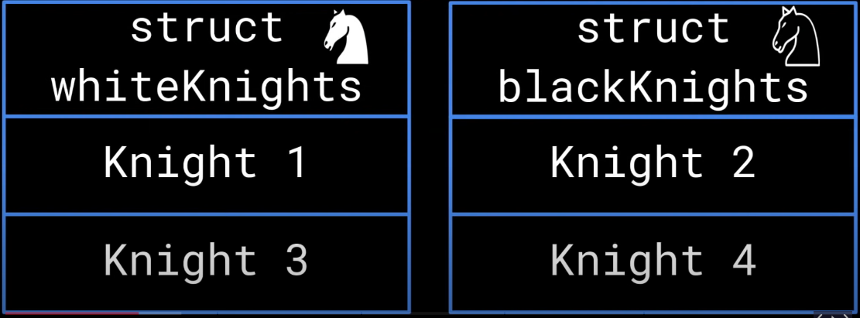
Can We use Structure?

Slide 20
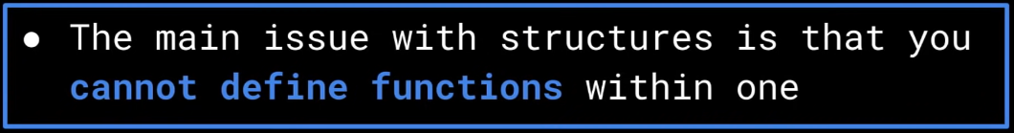
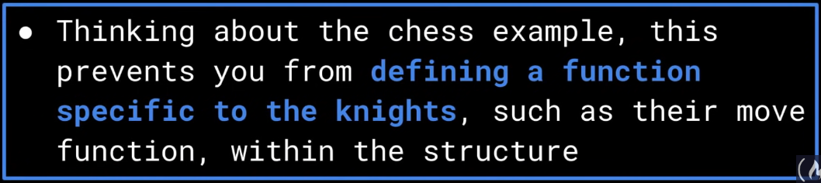
Can We use Structure?

Slide 21


What are Objects?
Circular Explanation?

Slide 22
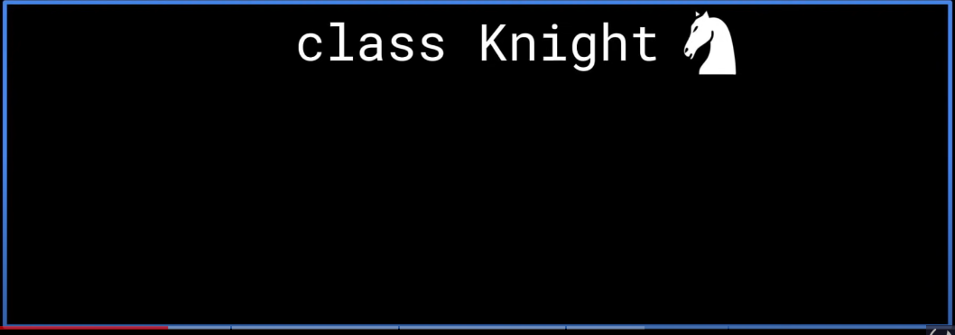
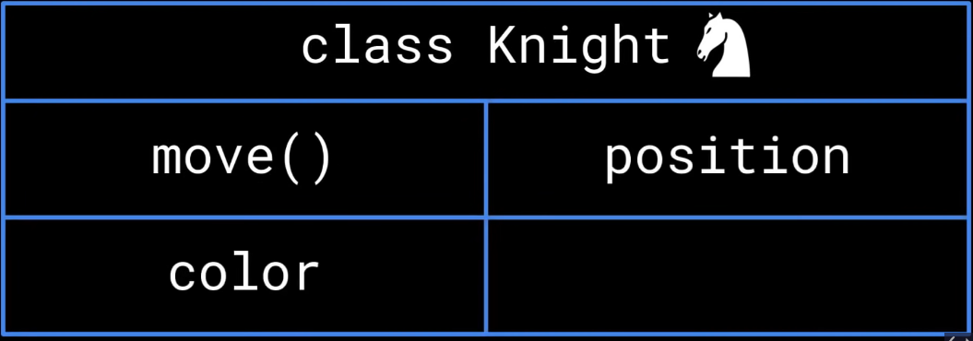

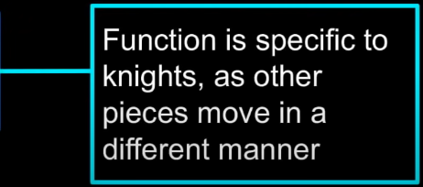
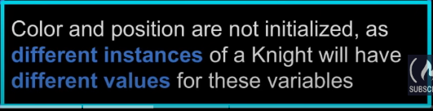
Class Attributes/Methods VS Instance Attributes/Methods Conundrum
Classes and Objects

Slide 23


Class vs Instance Attributes/Methods
Initialize Position From Inside the Class
Position: Instance Attributes

Slide 24

Class vs Instance Attributes/Methods
Move(): Class Methods

Slide 25
Unified Modelling Language Representation

Slide 26
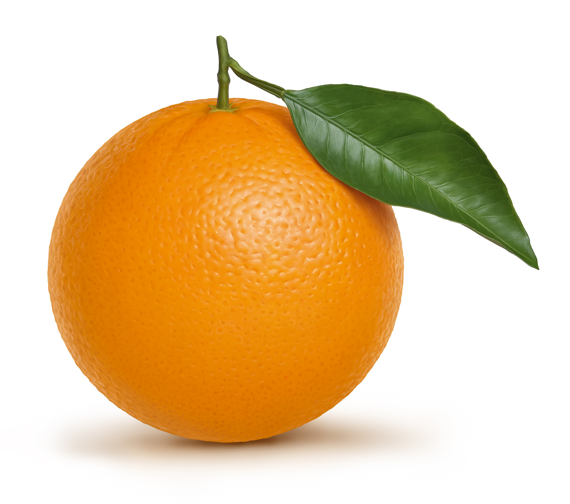
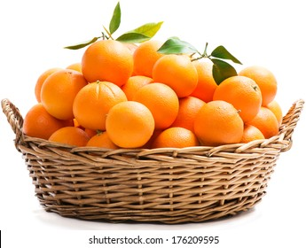
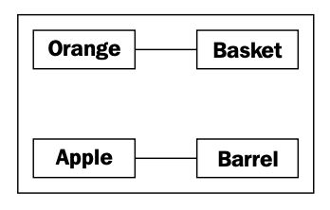
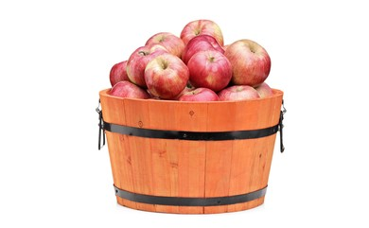
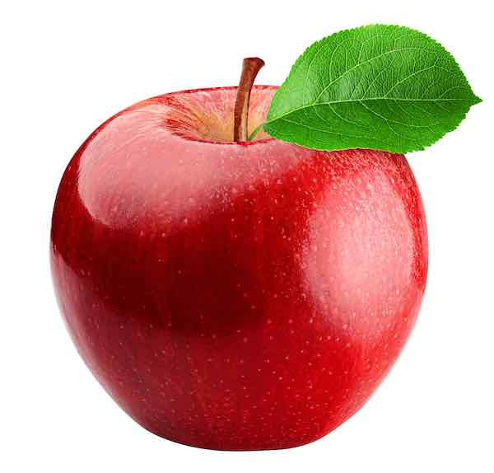
Classes and Objects in Unified Modelling Language

Slide 27
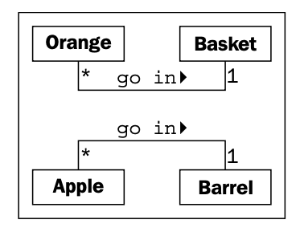
Classes and Objects in Unified Modelling Language
The beauty of UML is that most things are optional
We only need to specify as much information in a diagram as makes sense for the current situation
class diagram
Many Apples go in one Barrel
One Basket can hold many (represented by a *) Orange objects
Any one Orange can go in exactly one Basket

Slide 28
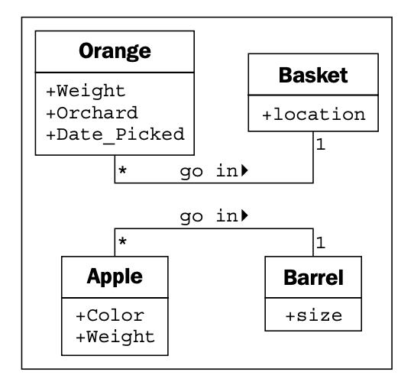
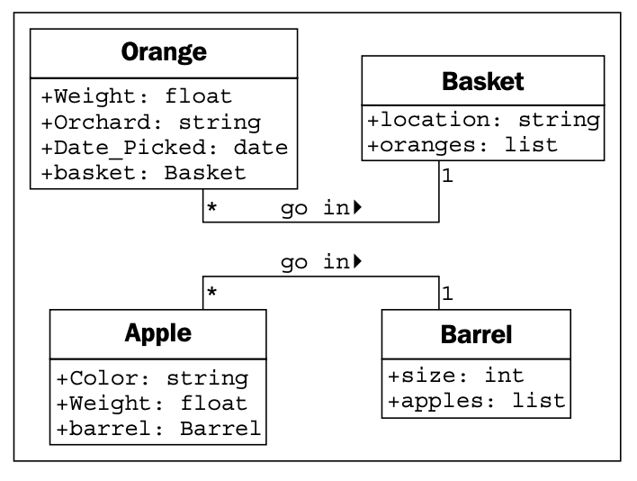
Classes and Objects in Unified Modelling Language

Slide 29
Four Main Principles of OOP
Encapsulation
Abstraction
Inheritance
Polymorphism

Slide 30
First Principle: Encapsulation

Slide 31
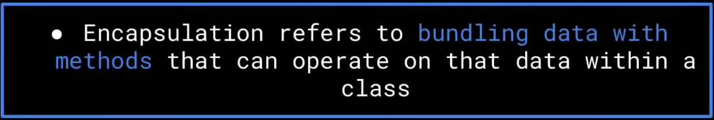
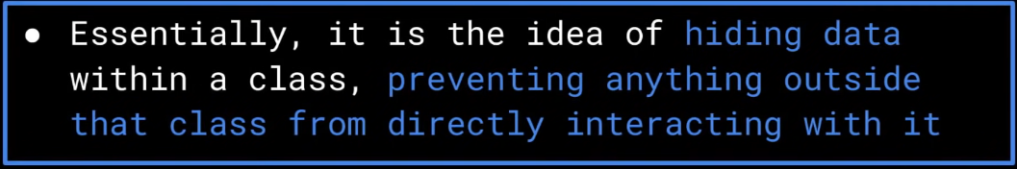
Encapsulation

Slide 32
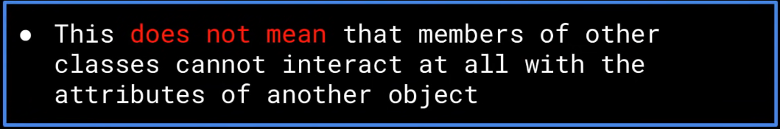
Encapsulation

Slide 33
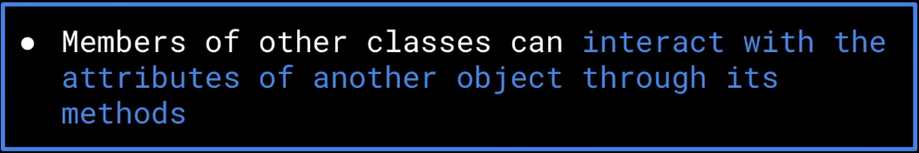
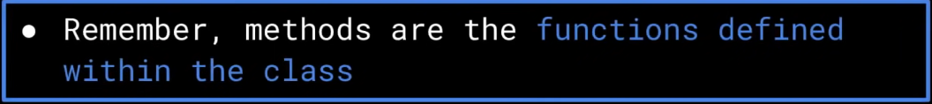
Encapsulation

Slide 34
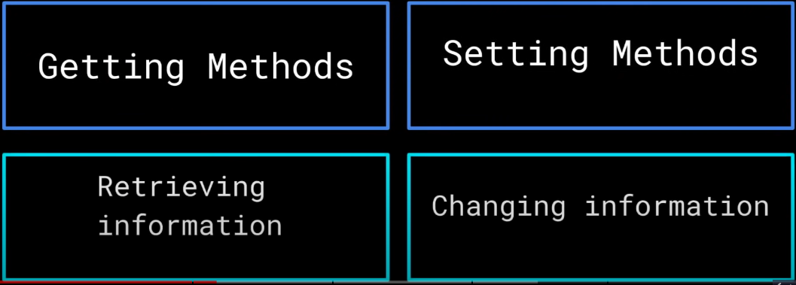
Encapsulation using Getter and Setter Methods

Slide 35

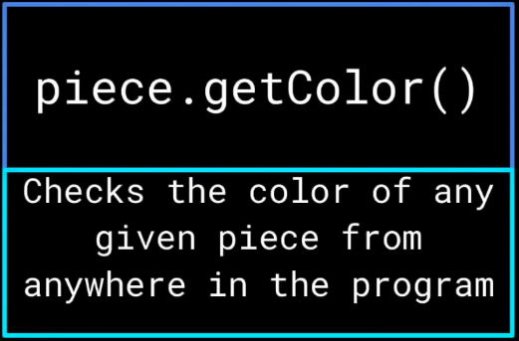
Encapsulation: Chess Example

Slide 36
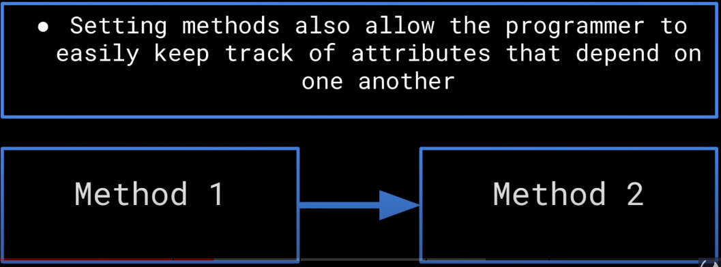
Encapsulation: Tracking Attributes

Slide 37
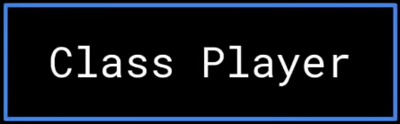

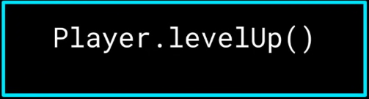


Encapsulation Example: Game

Slide 38
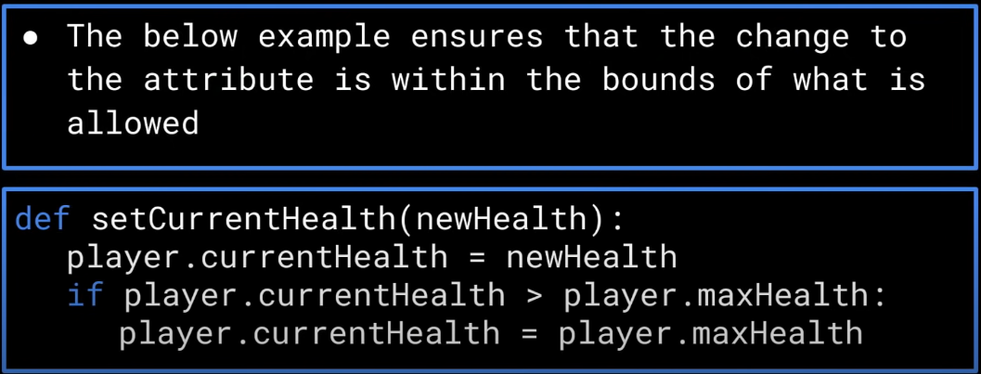
Encapsulation: Validation using Setter Method

Slide 39
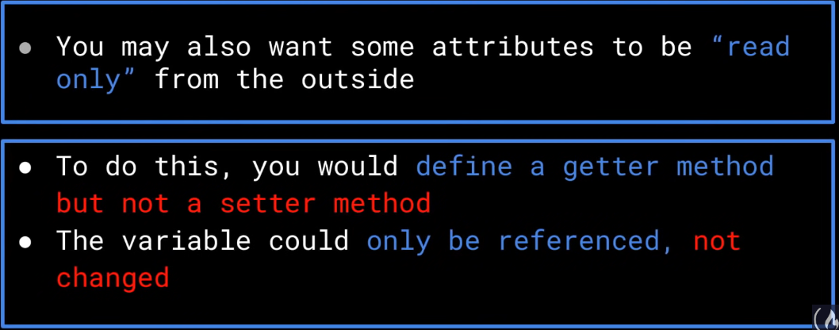
Encapsulation: Read only Attributes

Slide 40
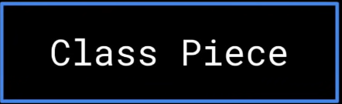
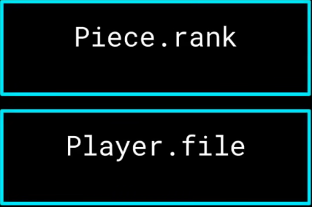
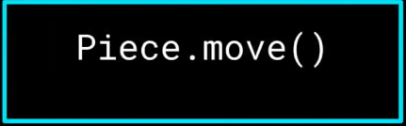
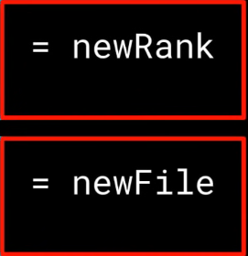

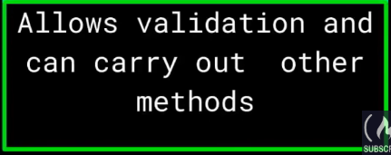
Encapsulation: Chess Example

Slide 41
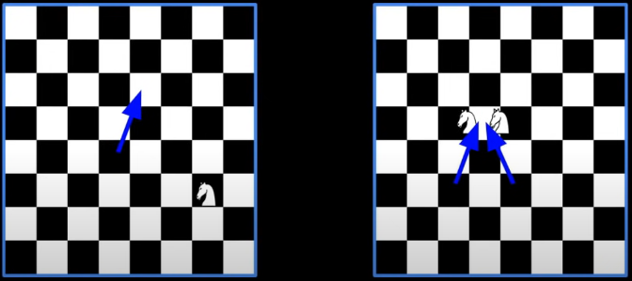
Encapsulation- Chess Example
If each piece can change its rank and file attributes directly, we may end up in invalid position such as:
Getter Methods that allows validation is very useful

Slide 42
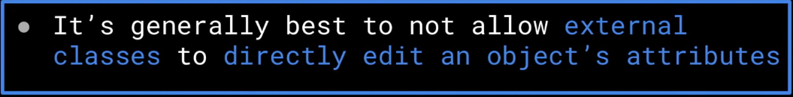
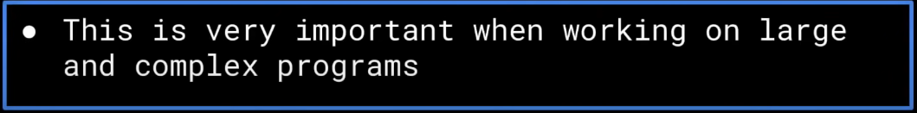
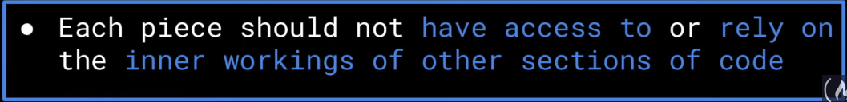
Encapsulation: Information Hiding

Slide 43

Encapsulation: Information Hiding

Slide 44

Encapsulation: Overview

Slide 45
Second Principle: Abstraction

Slide 46




Abstraction: Car Example

Slide 47



Abstraction: Car Example

Slide 48


Abstraction in OOP

Slide 49


Abstraction in OOP

Slide 50


Abstraction in OOP

Slide 51


Abstraction in OOP

Slide 52


Abstraction: Interface and Implementation

Slide 53




Abstraction: Interface and Implementation

Slide 54






Abstraction: Chess Example

Slide 55


Abstraction: Independence Against How Other class is defined

Slide 56

Abstraction: Interface and Implementation

Slide 57


Abstraction: Overview

Slide 58
Third Principle: Inheritance

Slide 59

Inheritance: Introduction

Slide 60



Inheritance: Game Example

Slide 61




Inheritance: Game Example

Slide 62


Inheritance: Class Hierarchy

Slide 63

Inheritance: Class Hierarchy

Slide 64


Inheritance: Access Modifier

Slide 65

Access Modifier: Public

Slide 66


Public Access Modifier: Example
Let’s say public attributes/methods are declared here

Slide 67


Access Modifier: Private

Slide 68

Private Access Modifier: Example
Let’s say private attributes/methods are declared here

Slide 69


Access Modifier: Protected

Slide 70

Protected Access Modifier: Example
Let’s say protected attributes/methods are declared here

Slide 71
Fourth Principle: Polymorphism

Slide 72

Polymorphism: Introduction

Slide 73


Dynamic Polymorphism

Slide 74


Dynamic Polymorphism

Slide 75



Dynamic Polymorphism: Car Example

Slide 76



Dynamic Polymorphism: Car Example

Slide 77

Dynamic Polymorphism: Car Example

Slide 78

Dynamic Polymorphism: Car Example

Slide 79


Dynamic Polymorphism

Slide 80


Static Polymorphism

Slide 81

Static Polymorphism

Slide 82

Static Polymorphism

Slide 83







Static Polymorphism: Car Example

Slide 84


Static Polymorphism

Slide 85


Static Polymorphism: Overview

Slide 86
Homework 1
Consider a student registration program used by the registrar’s office. The program keeps track of students who are registered for a given semester. For each student registered, the program maintains the student’s name, address, phone number, the number of classes in which the student is enrolled, and the student’s total credit hours. The program also keeps track of the total number of registered students. Define instance and class attributes of a Student class that is suitable for this program.
Suppose the minimum number and maximum number of courses for which a student can register are different depending on whether the student is a graduate, undergraduate, or work/study student. Redo Exercise 1 by defining classes for different types of students. Relate the classes, using inheritance.

